Slide 1









Whiteboardmaths.com
7
2
1
5
© 2008 All rights reserved

Slide 2
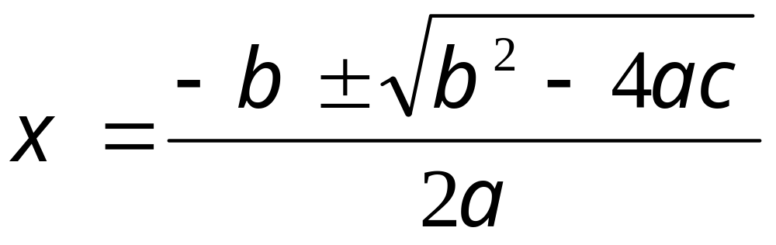
Menu
Quadratic Equations: The Common Formula
Deriving the
Formula →
Using the
Formula →

Slide 3
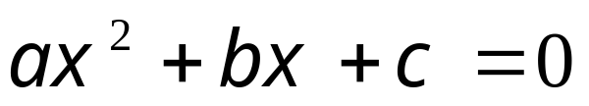
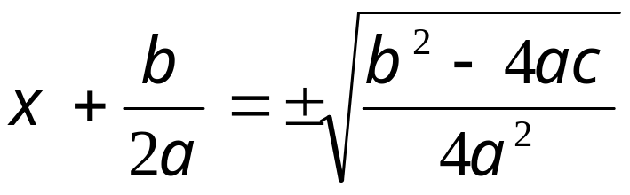
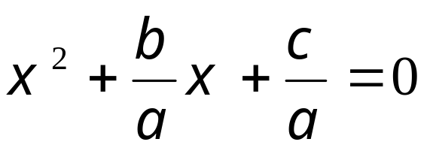
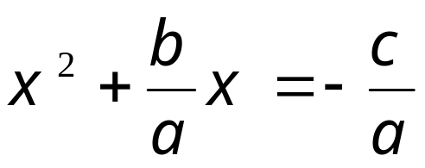
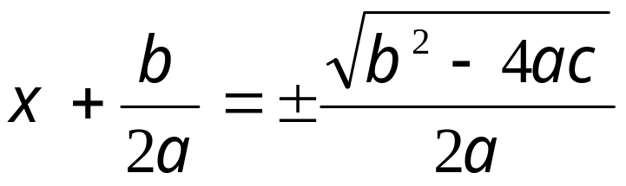
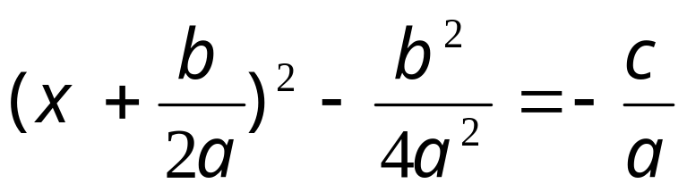
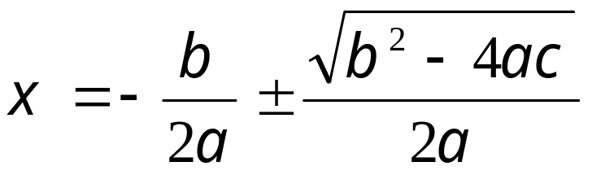
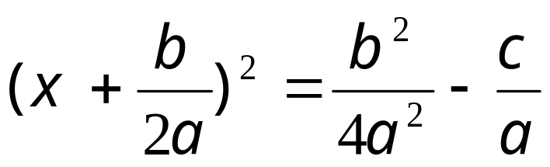

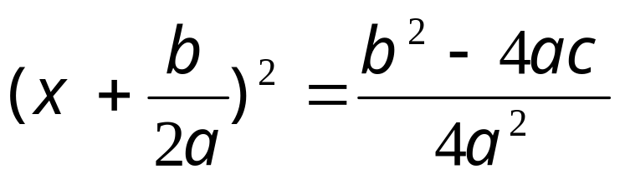
Deriving
< Menu
Quadratic Equations: The Common Formula
÷ by a
Complete
the square

Slide 4
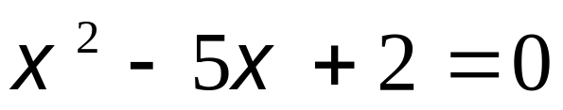
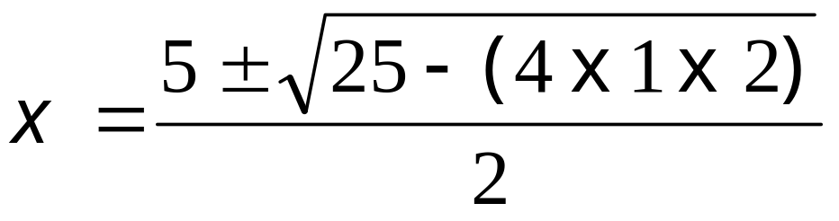
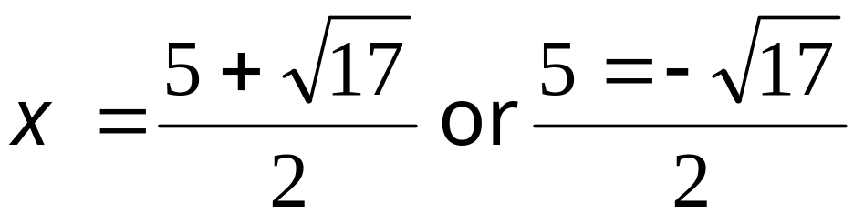
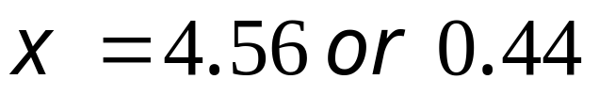
Example Questions
Quadratic Equations: The Common Formula
Example Question 1.
Use the formula to solve to 2 d.p.
a = 1
b = - 5
c = 2
Check solutions: 4.56² - 5 x 4.56 + 2 ≈ 0
Check solutions: 0.44² - 5 x 0.44 + 2 ≈ 0

Slide 5
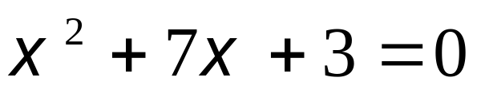
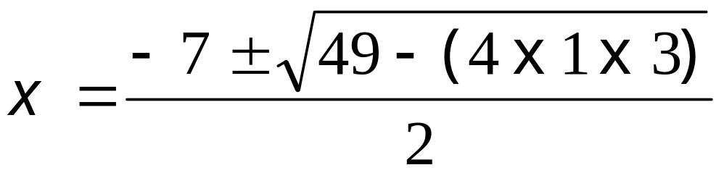
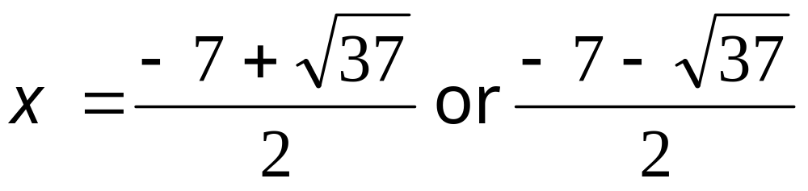
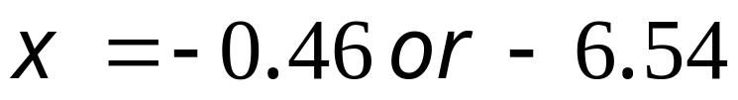
Quadratic Equations: The Common Formula
Example Question 2.
Use the formula to solve to 2 d.p.
a = 1
b = 7
c = 3
Check solutions: (-0.46)² + 7 x -0.46 + 3 ≈ 0
Check solutions: (-6.54)² + 7 x -6.54 + 3 ≈ 0

Slide 6
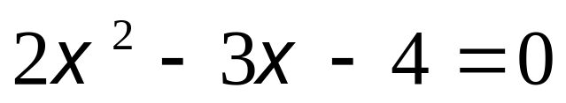
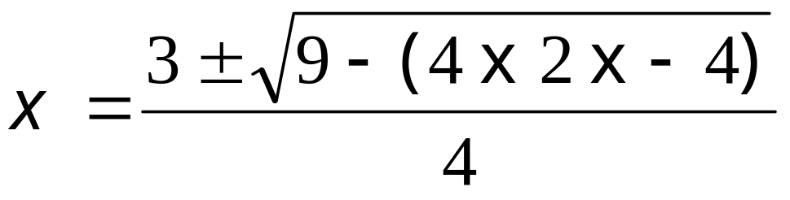
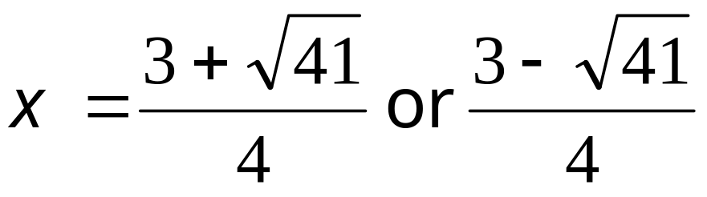
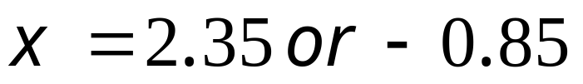
Quadratic Equations: The Common Formula
Example Question 3.
Use the formula to solve to 2 d.p.
a = 2
b = -3
c = -4
9 - (-32)
= 41
Check solutions: 2 x 2.35² - 3 x 2.35 - 4 ≈ 0
Check solutions: 2(-0.85)² - 3 x -0.85 - 4 ≈ 0

Slide 7
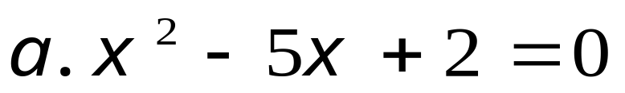

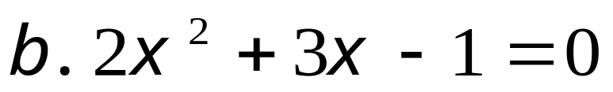

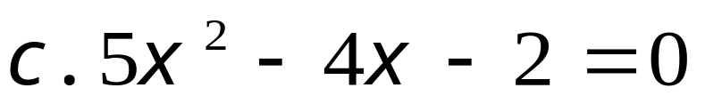

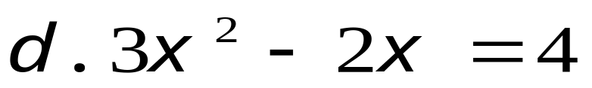

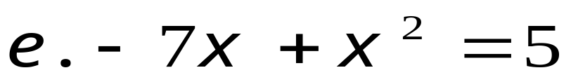

a,b and c
Quadratic Equations: The Common Formula
Questions.
The quadratic equations shown below are to be solved using the formula. Write down the values of a, b and c in each case.

Slide 8
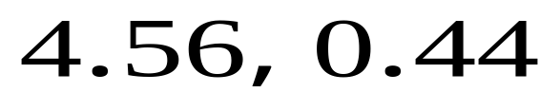
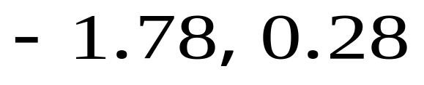
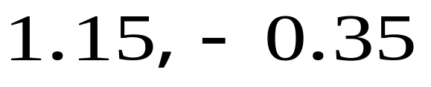
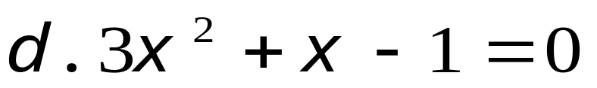
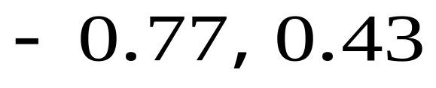
Q1 to 4
Quadratic Equations: The Common Formula
Questions.
Use the formula to solve the following to 2 d.p.

Slide 9
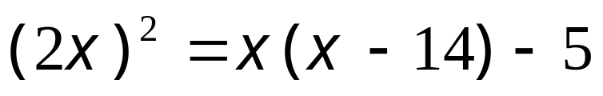
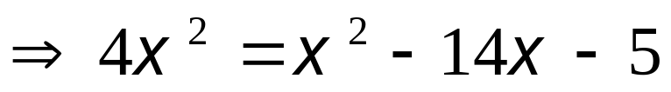
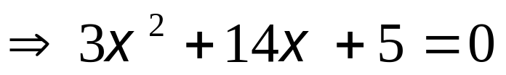
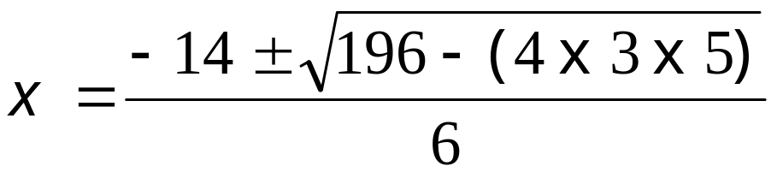
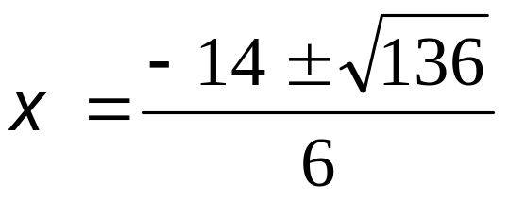
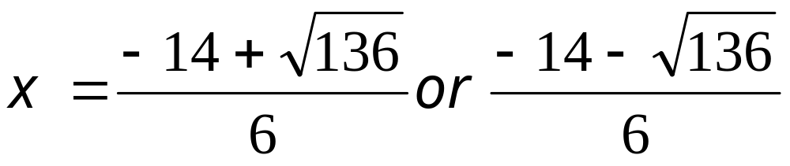
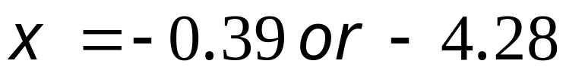
Example Q 4
Quadratic Equations: The Common Formula
Example Question 4.
The solution to a question may involve some re-arrangement of the terms to put it in the usual form.

Slide 10
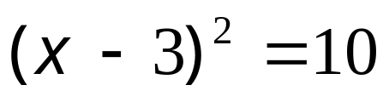
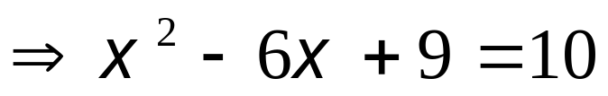
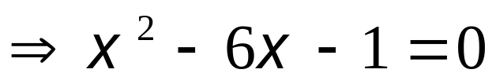
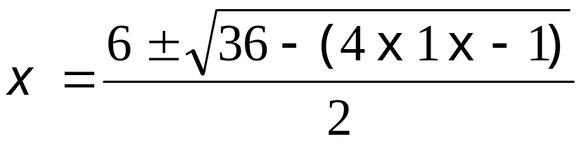
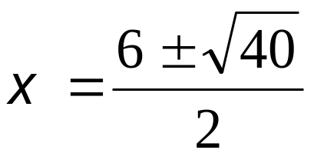
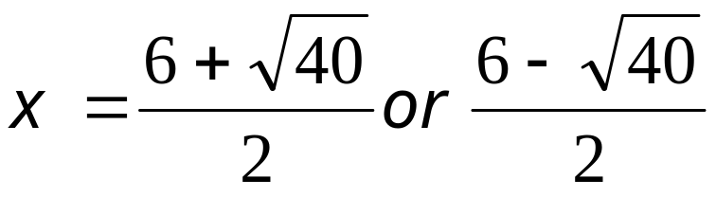
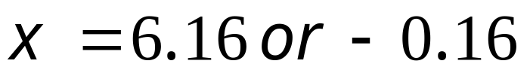
Question
Quadratic Equations: The Common Formula
Question 5.
Solve the quadratic equation to 2 d.p.

Slide 11
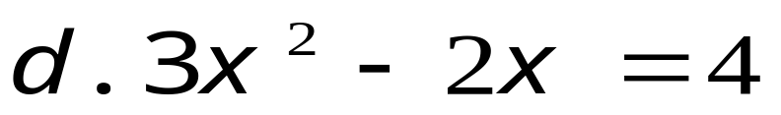
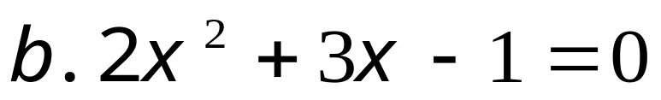
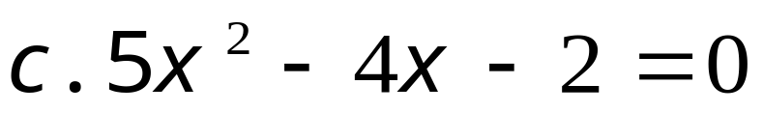
Worksheet 1
Worksheet 1
Quadratic Equations: The Common Formula
Example Question 1 to 3
Write down the values of a, b and c

Slide 12
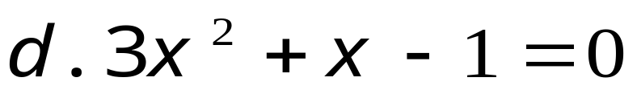
Worksheet 2
Worksheet 2
Quadratic Equations: The Common Formula
Questions.
Use the formula to solve the following to 2 d.p.
Example Question 4. Solve:
Question 5 . Solve:

